Slide 1
Project Success Metrics
Made by Sarina Ariamanesh
11-314a

Slide 2
Introduction
Project success metrics are essential indicators used to evaluate a project's success, enabling stakeholders to make informed decisions, identify areas for improvement, and demonstrate accountability. They help organizations refine their management processes, allocate resources effectively, and increase the likelihood of successful outcomes.

Slide 3
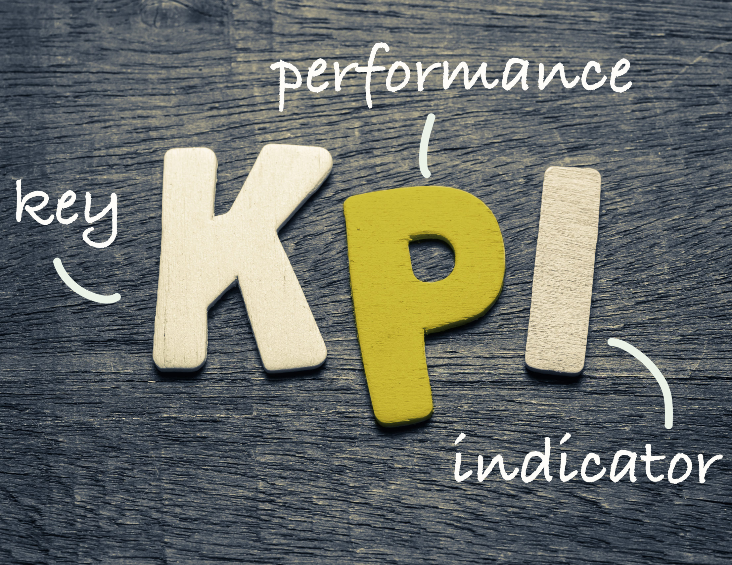
Definition of Key Performance Indicators (KPIs)
KPIs are quantifiable metrics used to measure project performance, such as cost, schedule, quality, customer satisfaction, and team productivity. They provide a clear, measurable way to assess progress, monitor activities, identify potential issues, and measure project success. They also facilitate effective communication and collaboration among stakeholders, ensuring successful outcomes and meeting objectives.

Slide 4
Types of Key Performance Indicators (KPIs)
Time-related KPI | Cost-related KPIs | Quality-related KPIs | Customer Satisfaction -related KPIs
Project Schedule Variance (PSV): Measures difference between planned and actual schedule. • Project Schedule Performance Index (SPI): Evaluates efficiency of schedule performance. • Cycle Time: Measures time taken to complete specific processes. • Lead Time: Measures time from project initiation to completion. | Cost Variance: Measures difference between planned and actual project costs. • Cost Performance Index: Evaluates cost performance efficiency. • Return on Investment: Measures financial return vs investment. • Cost of Quality: Measures cost of ensuring and maintaining project quality. | Defect Density: Measures defects per unit of work. • Customer Complaints: Tracks customer complaints. • First-Time Pass Rate: Measures quality standards without rework. • Customer Satisfaction Score (CSAT): Measures customer satisfaction with project outcomes. | Net Promoter Score (NPS): Measures customer referral likelihood. • Customer Retention Rate: Measures continued use of project's products/services. • Customer Effort Score (CES): Evaluates customer interaction and engagement. • On-time Delivery: Measures timely delivery of project deliverables/services.

Slide 5

Importance of Measurement in Project Success
Measuring project success is crucial for evaluating outcomes, tracking progress, and identifying areas for improvement. It helps stakeholders evaluate the project's effectiveness, enables proactive management, and helps identify bottlenecks. Regular monitoring of key performance indicators (KPIs) helps identify deviations and take corrective actions. This information guides decision-making, enhances future planning, and contributes to the overall success of the project.

Slide 6

Measurement of Project Success
Project success is measured using various methods and metrics, such as Key Performance Indicators (KPIs), Return on Investment (ROI), schedule adherence, quality of deliverables, stakeholder satisfaction, risk management effectiveness, resource utilization, and scope adherence. Aligning project goals with measurable outcomes ensures clarity of objectives, focus on results, accountability, and continuous improvement, preventing deviations and enhancing project performance over time.

Slide 7
Criteria for Project Success
Meeting Objectives
Delivering Within Budget
Completing Within Schedule
The project's success is determined by its ability to achieve its defined objectives, deliver desired outcomes, meet project goals, and fulfill its purpose.
Effective cost management, cost avoidance, and efficient utilization of financial resources are crucial for project success.
The project's timely completion is a crucial aspect, requiring effective management of activities, milestones, and dependencies.
Quality of Deliverables
Stakeholder Satisfaction
Risk Management
The project's success is significantly influenced by its outputs, which must meet or surpass predetermined standards, specifications, and customer expectations.
Stakeholder satisfaction is crucial, as positive feedback indicates the project has met their needs, addressed their concerns, and delivered value.
Effective risk management is crucial for project success, as it minimizes potential threats and maximizes opportunities..

Slide 8

Areas for Improvement
Identifying areas for improvement in project management is crucial for enhancing efficiency, risk mitigation, meeting stakeholder expectations, adapting to changing environments, aligning practices with organizational goals, fostering employee development, and encouraging innovation. It also helps refine processes, implement corrective actions, enhance decision-making, and build a culture of continuous improvement. By learning from past experiences, addressing shortcomings, and implementing lessons learned, organizations can enhance their project management practices and increase the likelihood of success in future endeavors.

Slide 9

Case Study or Example
The Burj Khalifa in Dubai, the tallest building in the world, was built using key performance indicators (KPIs) to track progress and ensure success. KPIs included time, cost, quality, and safety to monitor progress and ensure the building met schedules. Regular progress reports, inspections, and audits were conducted to assess performance against KPIs. Lessons learned were actively documented and analyzed to identify challenges and develop strategies for future improvements. By utilizing KPIs, measurement, and lessons learned, the Burj Khalifa achieved project success by completing within schedule, staying within budget, maintaining high-quality standards, and ensuring worker safety.

Slide 10
Conclusion
The presentation highlighted the significance of project success metrics, Key Performance Indicators (KPIs), and lessons learned for continuous improvement. These metrics measure project success, such as meeting objectives, staying within budget, and delivering high-quality results. KPIs provide quantifiable performance evaluations, such as cost performance and customer satisfaction. Continuous improvement involves identifying areas for improvement and corrective actions. Lessons learned from past projects help avoid mistakes and improve future projects.

Slide 11

Thank you for your attention!

